Slide 1
RA 505 Robot Sensing and Vision Lecture 34
Dr. Rishikesh Kulkarni
Department of Electronics and Electrical Engineering
IIT Guwahati

Slide 2
Accelerometer
Device to measure
Acceleration
Vibration
Shock
Velocity
Position
Applications in
Automotive
Medical
Industrial control
Robotics
Types
Hall effect
Piezoelectric
Piezoresistive
Capacitive
Position

Slide 3
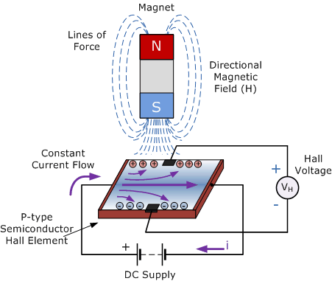

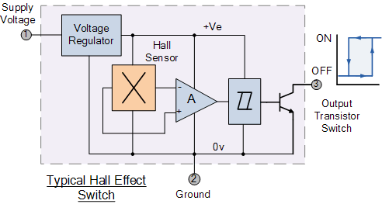
Hall effect based Accelerometer
Output signal from a Hall effect accelerometer is the function of magnetic field density around the device
Hall Effect Sensors
A thin piece of rectangular p-type semiconductor material
Gallium arsenide (GaAs), indium antimonide (InSb) or indium arsenide (InAs)
A continuous current is passed through it
Magnetic force (Lorenz force) experienced by charge carrier displaces them
Hall voltage (VH)
Built-in DC amplifiers, logic switching circuits and voltage regulators
Bipolar/unipolar

Slide 4
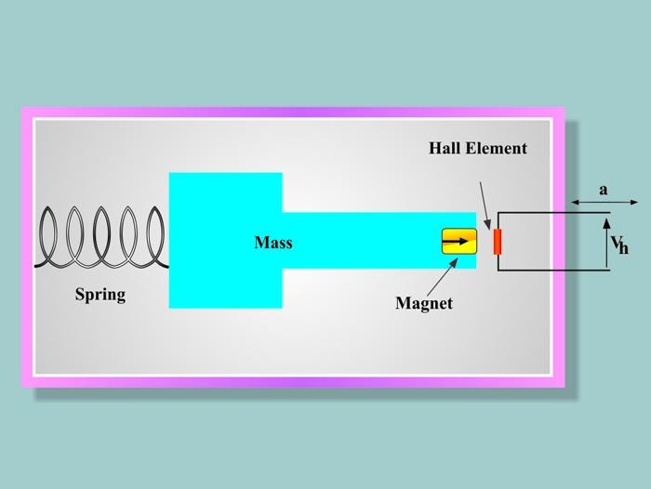
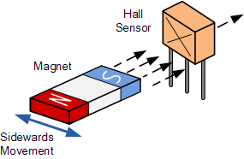
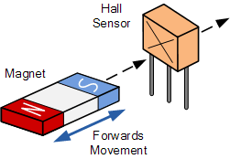
Hall effect based Accelerometer
Types of magnet movements, such as “Head-on”, “Sideways”, “Push-pull” or “Push-push” etc. sensing movements.
Useful in environmental conditions consisting of water, vibration, dirt or oil

Slide 5
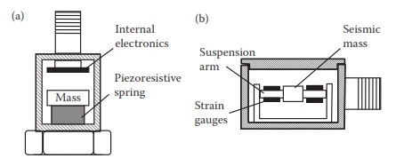
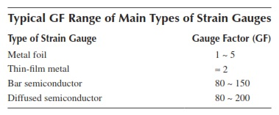

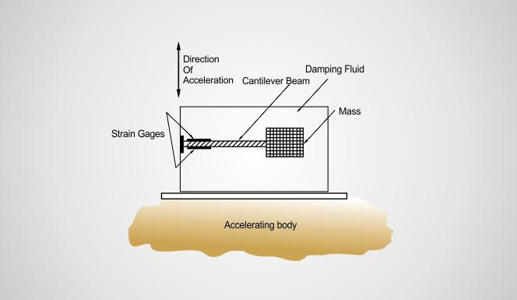


Piezoresistive Accelerometer
can measure both dynamic and static accelerations.
Gauge dimension, gauge factor, power dissipation
Creep: nonideal elastic behaviors of piezoresistors and adhesive materials
Temperature coefficient of resistance (TCR)
Temperature coefficient of sensitivity (TCSR),

Slide 6
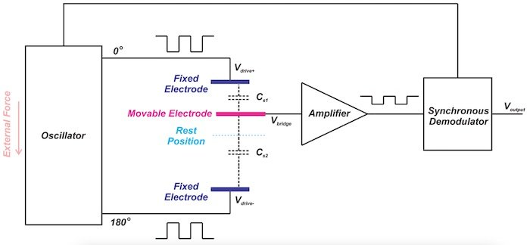
Capacitive Accelerometer
Spring-mass system
Change in capacitance due to change in distance between movable and fixed plate

Slide 7
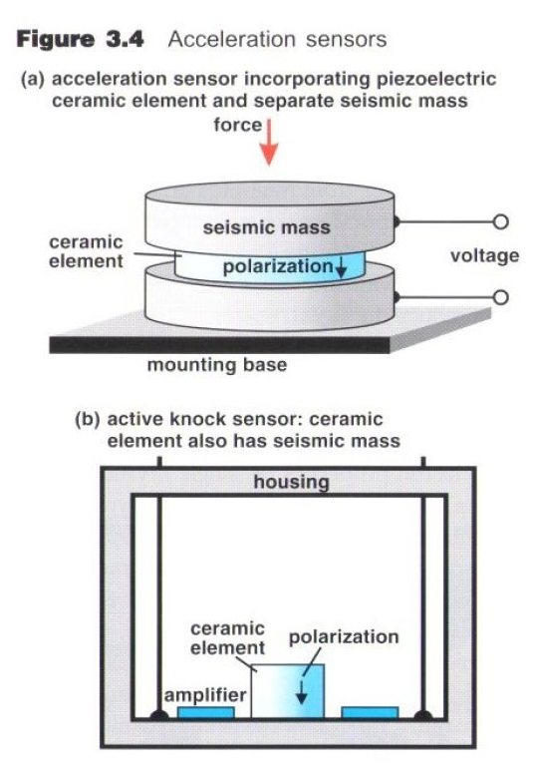
Piezoelectric Accelerometer
Piezoelectric material slice: Polarized ceramic
Advantages
Frequency response
Temperature stability
Ruggedness
Adaptability
Electrical characteristics

Slide 8
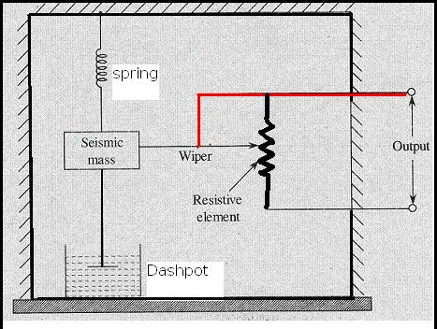
Potentiometric Accelerometer

